Slide 1
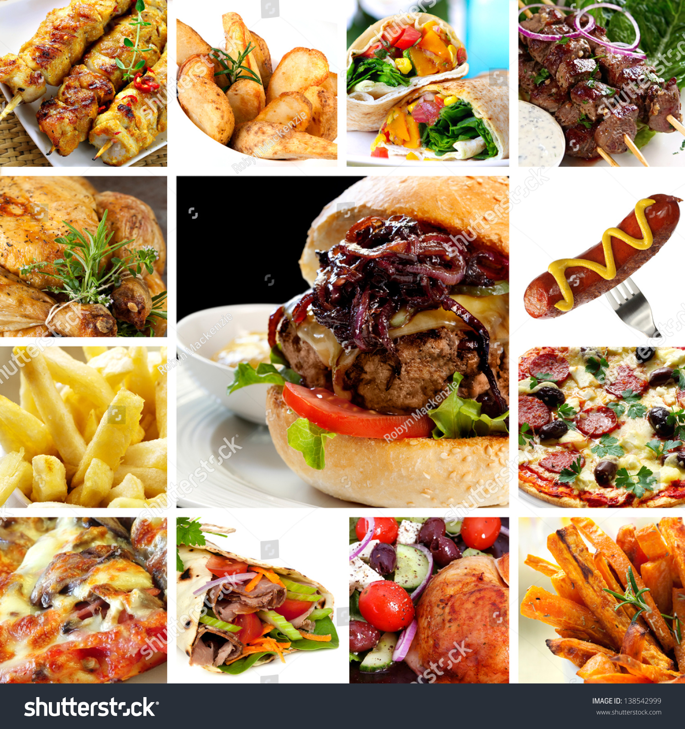
CASE STUDY ON BTM LAYOUT FAST FOOD CENTRE
-Analysis and Solution for BTM Layout Fast food center
By T Bhuvaneswar

Slide 2
Business problem: A man has took a shop in Rent near BTM Layout, Bangalore, not in the main road but as a local shop. The rent of the shop is 13500 per month. The man took the shop to sell fast food
In the first 3 months he make a profit of around 100000, with a sales of around 300000.
In the 1st month he was selling veg food also, but he stopped after the 2nd month as it stock was not getting out.
After 4 – 5 months down the line the man is making a huge loss in his investment. He has a due of 2 months to pay the rent.
The sale has drastically gone down and he is thinking to close the shop.
KPI for the cause of business fall down
What is the open time of the fast food center and other competitors?
What are the differences between competitors and fast food center?
What are the price difference of the fast food center and with competitors?
Quality of the food between competitors?

Slide 3
MONTHLY SALE DATA
Month | Sum of Monthly sale | Sum of Profit(Monthly sale-Total Expenses)
May | 163530 | 83030
June | 84480 | 7430
July | 54170 | 6690
August | 25470 | -21320
September | 11620 | -33280
Grand Total | 339270 | 42550
The sale trend started with positive note, From second month sale reduced slowly, and after 2nd month vegetarian removed from the menu due to stock is not getting over.
After 4 – 5 months down the line the man is making a huge loss in his investment. Even he has a due of 2 months to pay the rent.

Slide 4
FOOD PRICES COMPARISION WITH COMPETETORS
Row Labels | Chicken fried rice | Chicken Kabab(Half) | Chicken noodles | Chicken Kabab(Full) | Egg fried rice | Veg fried rice | Gobi Manchurian | Veg noodles
BTM Fast Food Center | 75 | 40 | 65 | 80 | 65 | 65 | 45 | 55
Competetor-1 | 70 | 40 | 60 | 80 | 65 | 55 | 45 | 50
Competetor-10 | 70 | 40 | 60 | 70 | 60 | 55 | 50 | 55
Competetor-2 | 70 | 35 | 60 | 70 | 65 | 55 | 45 | 50
Competetor-3 | 65 | 40 | 55 | 70 | 65 | 60 | 50 | 55
Competetor-4 | 70 | 40 | 60 | 70 | 60 | 55 | 45 | 50
Competetor-5 | 70 | 40 | 60 | 70 | 65 | 55 | 45 | 50
Competetor-6 | 75 | 40 | 65 | 75 | 65 | 55 | 45 | 50
Competetor-7 | 70 | 40 | 60 | 70 | 65 | 65 | 45 | 60
Competetor-8 | 70 | 40 | 60 | 75 | 65 | 55 | 40 | 55
Competetor-9 | 60 | 30 | 50 | 55 | 50 | 45 | 40 | 40
Grand Total | 765 | 425 | 655 | 785 | 690 | 620 | 495 | 570
Competetor Average Cost | 69 | 38.5 | 59 | 70.5 | 62.5 | 55.5 | 45 | 51.5
KEY POINT INDICATORS DISCUSSION
Center open time is late and close time is early than other competitors. Total functioning hours is to less.
No seating availability.
Quality of the food and service is poor.
No home delivery facility.
Food prices is high than the other competitors.

Slide 5
Actions to be taken to improve business
Increase the functioning hours, Fast food center to be open at 16:00 or before and food center should be close at 22.30 or later.
To attract the students and visitors seating to be arrange in attractive.
Quality of the food to be increase and also fast food center to be keep in clean.
To increase sales make tie up with delivery partners like Zomato, Swiggy .
Introduce veg food also to increase the sales with monitoring the consumption of the vegetables.
Reduce the prices of the food items.
Provide discounts on the sale , like Rs. 500 bill give 5% discount, Rs.1000 bill give 7% discount.
END OF THE CASE STUDY----THANK YOU.

